Slide 1
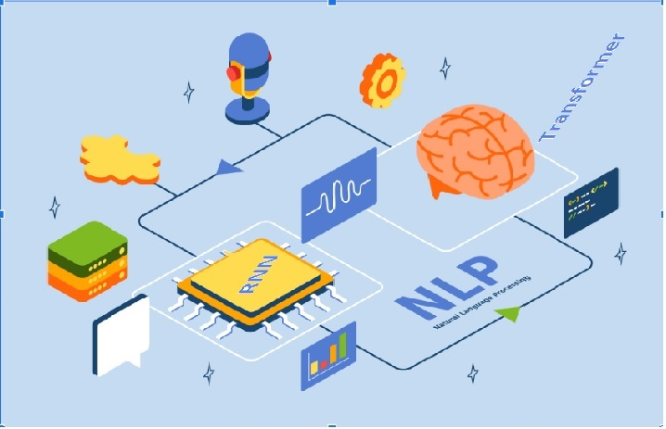
RNN, NLP & Transformers Basic Concepts

Slide 2
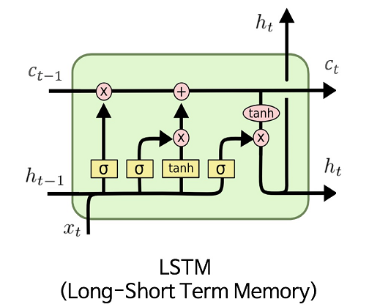
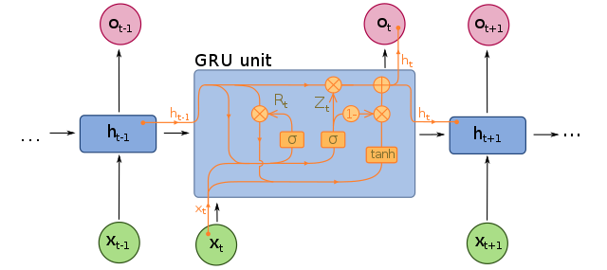
LSTM & GRU in RNN
GRU
(Gated Recurrent Unit)
LSTM 3gate(i/p,forget,o/p), GRU 2gate(reset(STM),update(LTM))
LSTM 2 states(cell (LTM), Hidden(STM)), GRU(Hidden)

Slide 3
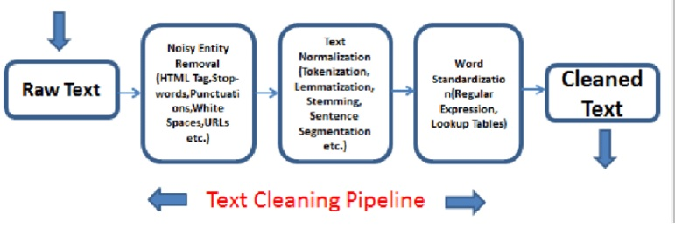
Natural Language Processing

Slide 4
Feature Engineering on Text Data
Syntactic Parsing
Entity Extraction or detection
Statistical Features
Word Embedding
2 methods:
(NER) Named Entity Recognition
Topic Modelling
N-Gram
Dependency Tree
Part of speech(POS)
(TF-IDF) Term frequency- Inverse document frequency
Count/ Density/ Readability feature
Representing words as vectors.
2 models: Word2Vec GLoVe
TF-IDF = t*log(n/doc(t))
t=no. of occurrence of term t
n= total no. of documents
doc(t)=documents containing term t

Slide 5
RNN Sequential Encoding Decoding Processing

Slide 6
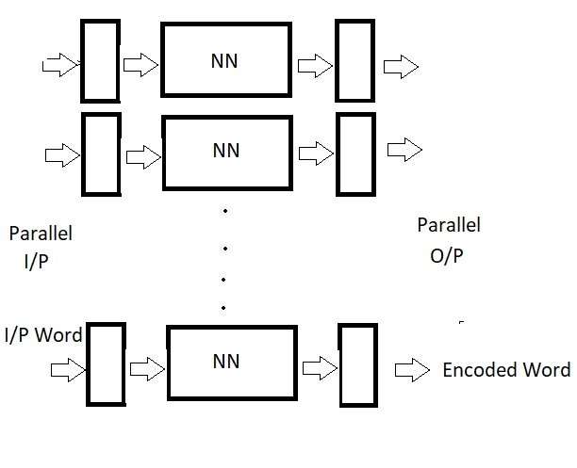
Parallel Processing

Slide 7
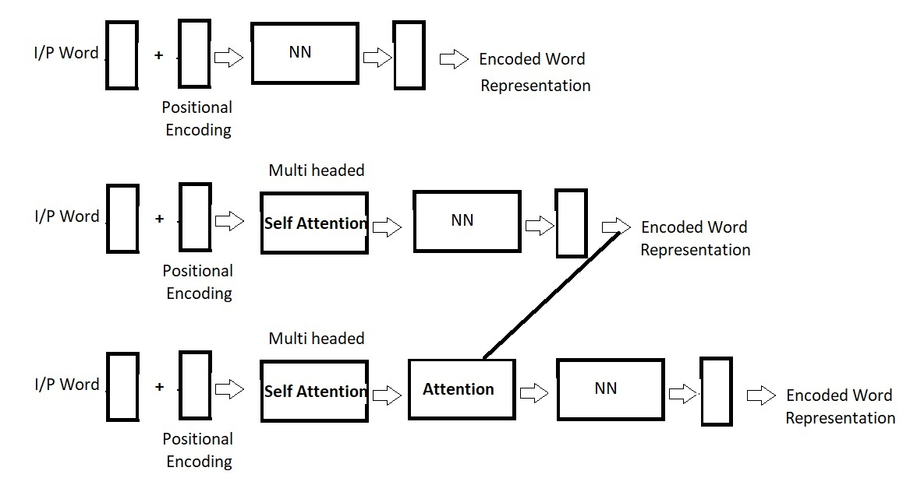
Transformer Architecture

